Slide 1
Aerodynamic design
In this part trying to build more efficient vehicle which satisfy aerodynamics rules, to achieve requirements:
Mission
Flying taxi which takeoff and landing at streets of the city
Constraints
Max. takeoff weight about 3 Kg.
Max. wide of vehicle 0.8 meter.
Minimum length for easy landing at any place.

Slide 2
Wing configuration
There are a lot of wing configuration but the suitable configuration for our vehicle constraints and mission should be chosen.
Since one of the important constraint of the flying taxi is to have small size, small span.
constraint should be achieved with generating the required lift so tandem wing plane is preferred to be used to get greater lift than conventional wing, as it has two independent source of lift (two wings) to be able to manage the takeoff weight.

Slide 3
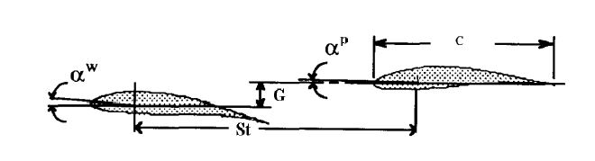
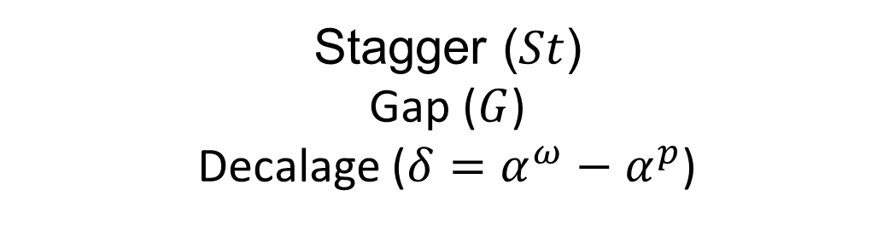
Design parameters of Tandem wing plane
Stagger ($St$)
Gap ($G$)
Decalage ($δ=α^{ω}−α^{p}$)

Slide 4
Design Criterion

Slide 5
Airfoil selection
there is two constraints in this section:
- The thickness of the standard foam sheets (in some cases it was little than the camber of the airfoil).
- Highly cambered airfoils are difficult to be manufactured using foam cutter machine (less accuracy).
airfoils that have high lift and low Reynold number; such as (Eppler421, Eppler423, MH14, NACA0018, NACA0015, Clark(Y) and NACA632615) are analysed, then suitable airfoil is chosen according to the previously stated constraints and requirements.

Slide 6
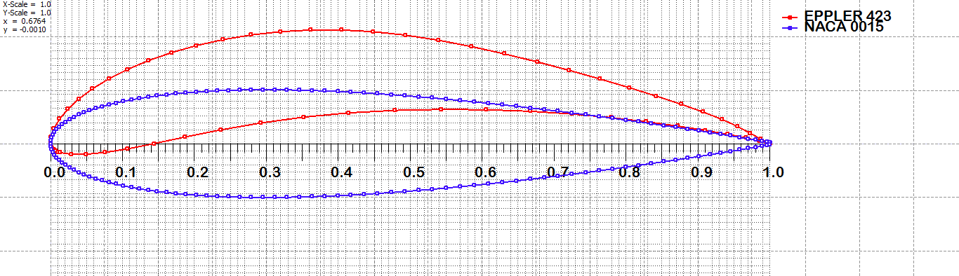
Eppler423 (higher lift)
NACA0015 (easy to manufacture)

Slide 7
Analyzed airfoils
Shown below the boundary layer thickness and pressure distribution along the two selected airfoils with change at angle of attack from: (0 to 6 & 0 to -4 ) degree.
And later one of them will be selected at a certain angle of attack and certain Reylonds number.

Slide 8
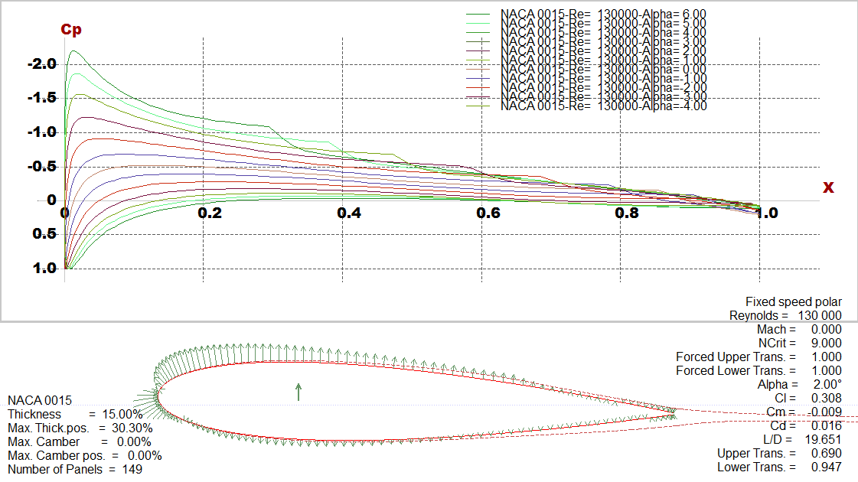
NACA0015

Slide 9
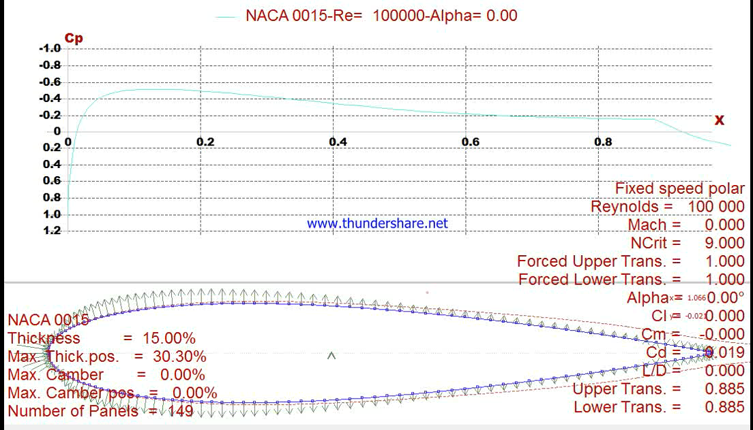

Slide 10
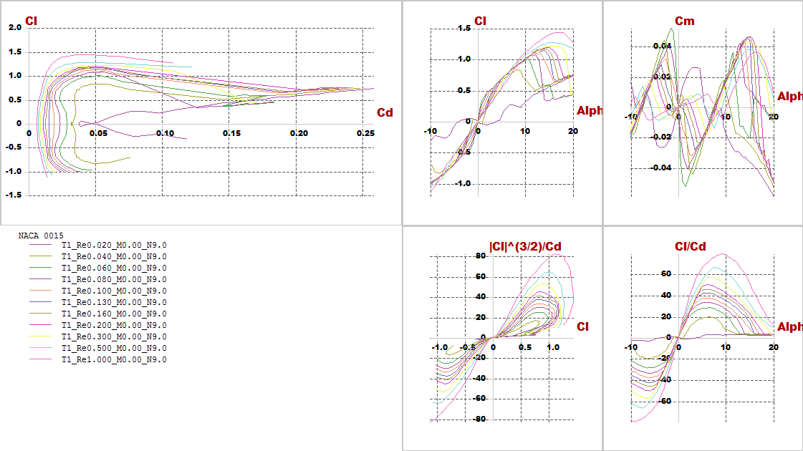
Polar graph with difference Reylonds number

Slide 11
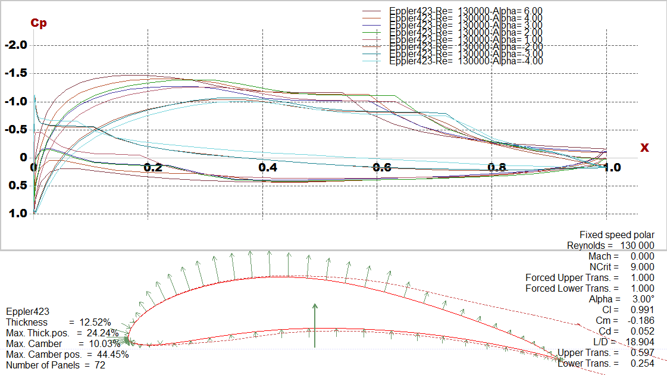
Eppler423

Slide 12
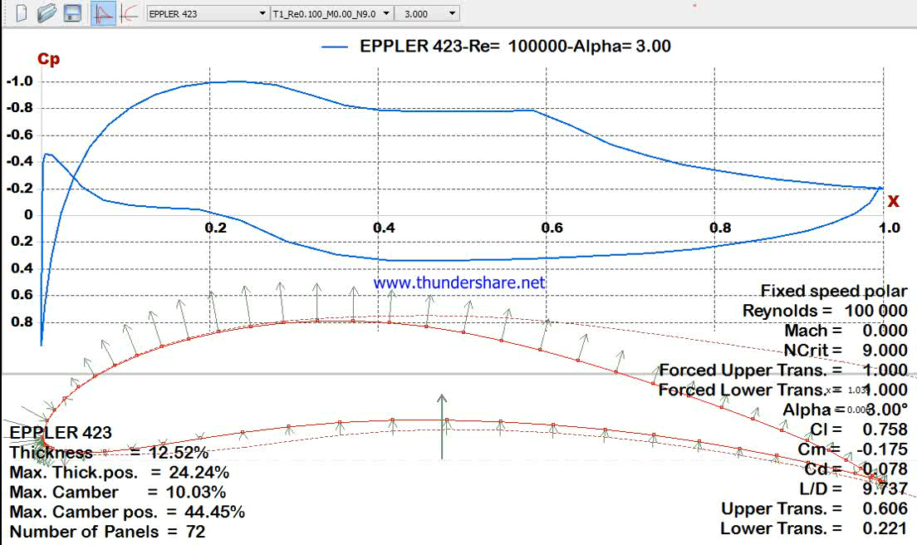

Slide 13
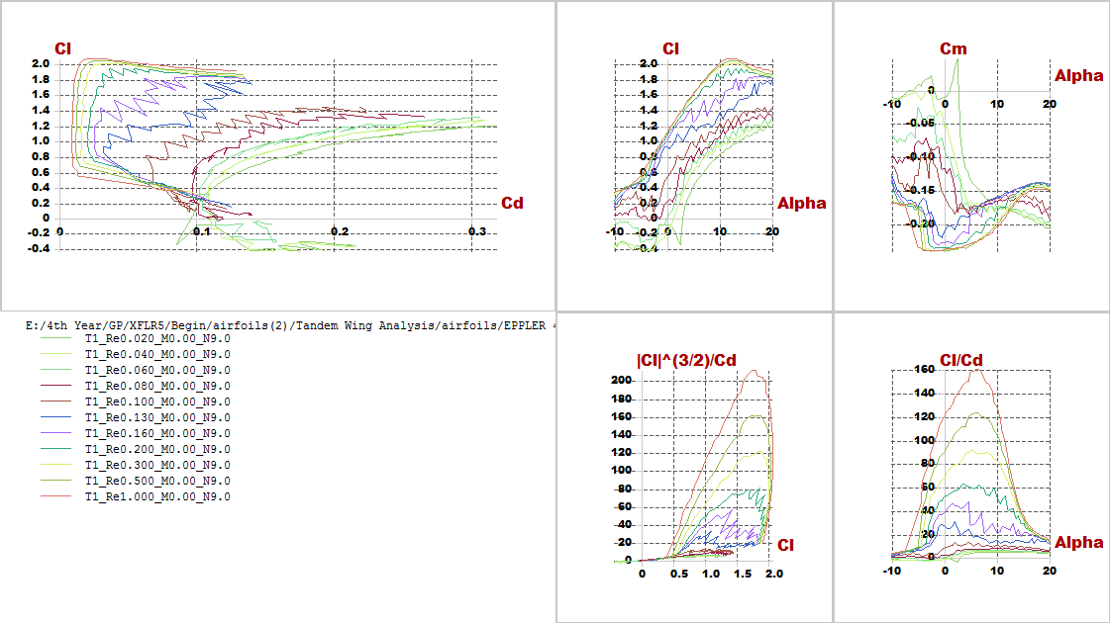
Polar graph with difference Reylonds number

Slide 14
Aerodynamic analysis

Slide 15
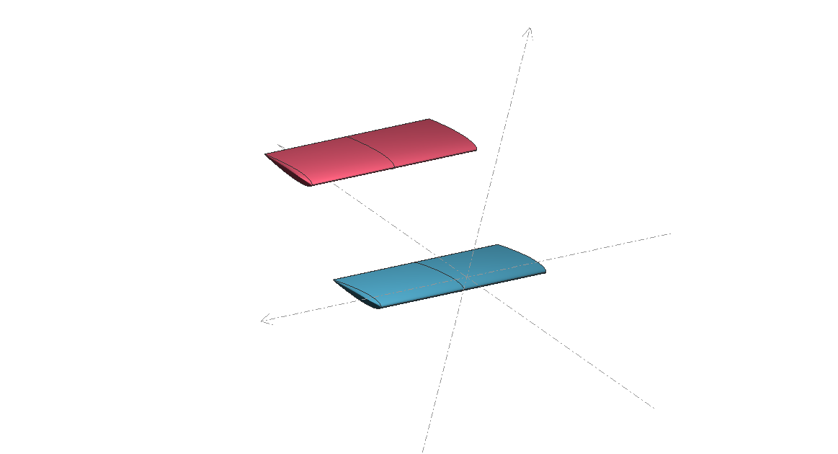
After trying different trials considering constraints and requirements, the best configuration has been chosen then stability and lift produced is

Slide 16
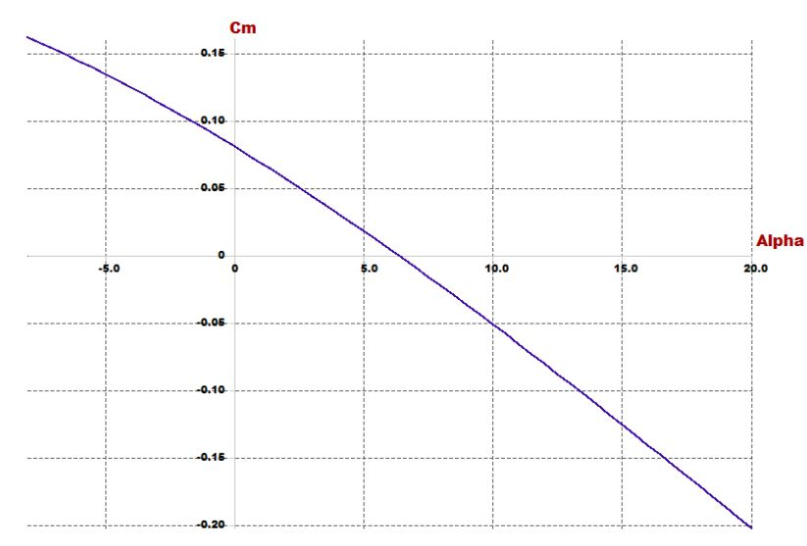
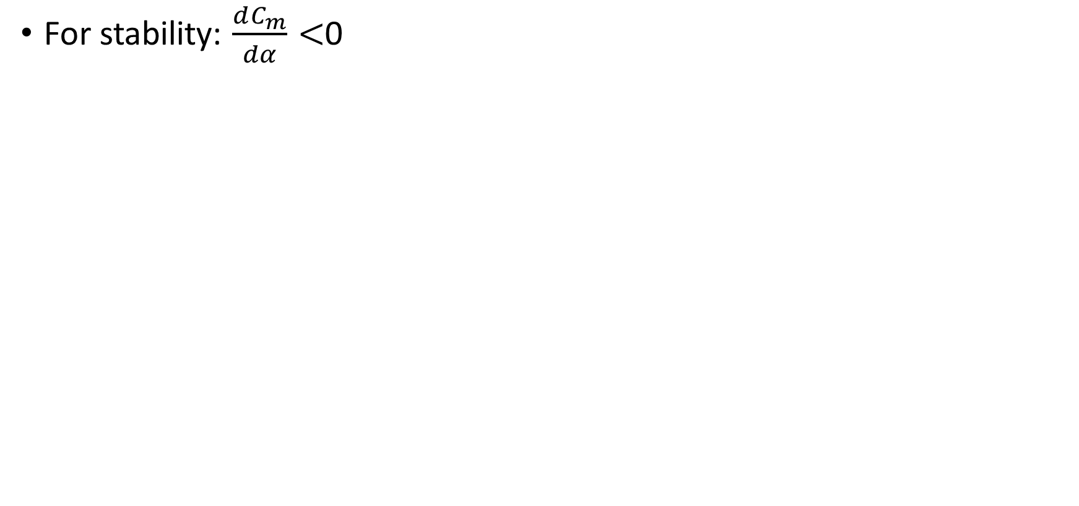
Investigating goals and requirements
For stability: $\frac{dC_{m}}{dα}<$0

Slide 17
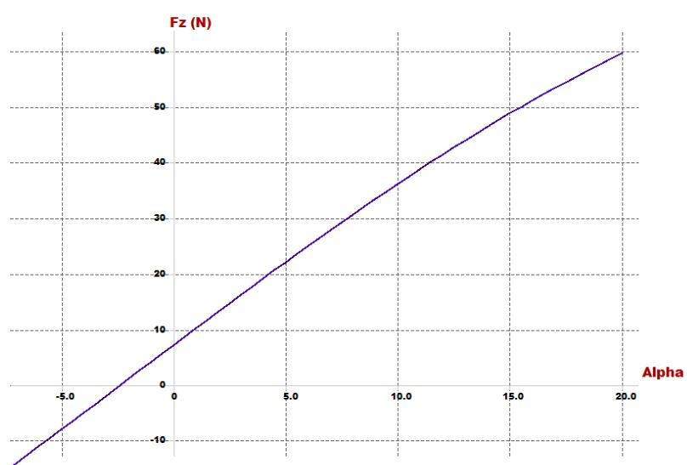
For lift: At trim angle the lift must carry the vehicle

Slide 18
Design parameters
In this part stability of quad-plane is checked and the airfoil design parameters (incidence angle, CG position, cruise speed and dimensions of wings) is chosen
Parameter | Effect on the vehicle
Span | proportional with lift
Chord | proportional with lift
Cruise speed | proportional with lift
Arm | Static stability
Incidence angle | Static stability
Position of CG | Static stability
Position of second wing | Static stability

Slide 19
Results

Slide 20
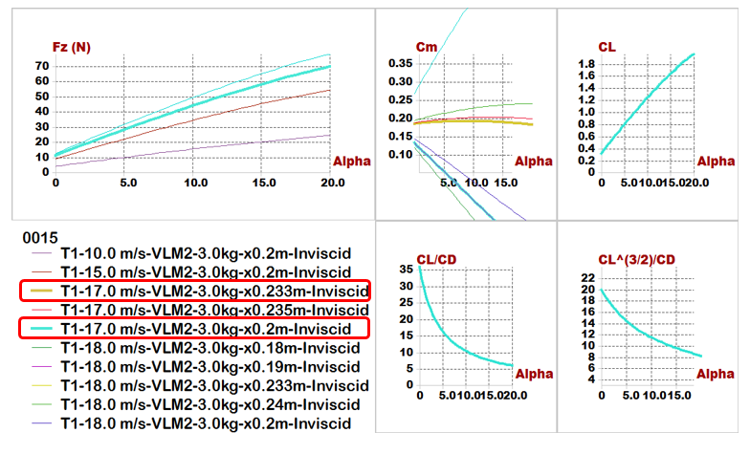
Plane analysis(NACA0015)

Slide 21
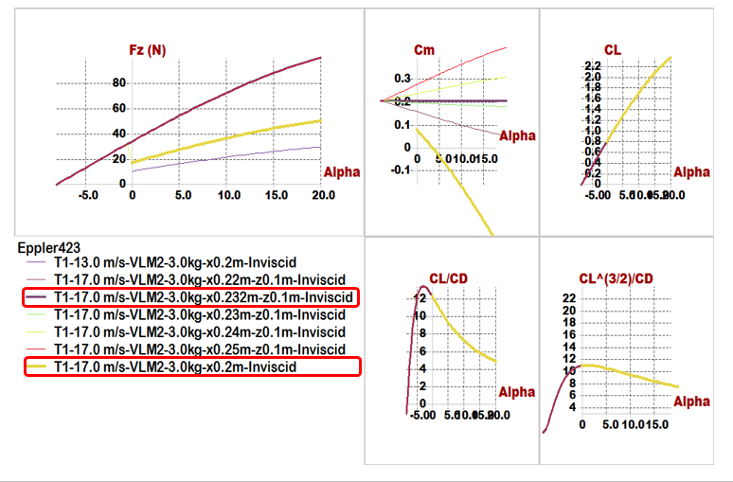
Plane analysis(Eppler423)

Slide 22
Quick comparison between 2 airfoils
Comparisons \ Models | Model 1 (NACA0015) | Model 2 (Eppler423)
Position of Main wing | x= 0, z= -0.05 m | x= 0, z= -0.05 m
Position of Second wing | x= 0.45 m, z= 0.1 m | x= 0.45 m, z= 0.15 m
Span | 0.8 m | 0.6 m
Chord | 0.25 m | 0.2 m
Aspect ratio | 3.2 | 3
Cruise speed | 17 m/s | 17 m/s
Incidence of Main wing | 5 degree | 3 degree
Incidence of Second wing | 2 degree | -8 degree
Trim angle | 5.1 degree | 3.6 degree
𝑿_𝑪.𝑮 | 0.19 m | 0.2 m
𝑿_𝑵.𝑷 | 0.233 m | 0.25 m
Degree of Static Stability (S.M.) | 17.2% | 25%

Slide 23
Conclusion of results:
For configuration:
We illustration the main reason to select tandem wing plane to get greater lift than conventional wing, because we have two independent source of lift (two wings).
Then now we can say the reason of vertical distance (Gap) between 2 wings that can affect the resulting vortex and vortex interactions that the wing spacing has a noticeable effect on the resultant flow field and aerodynamic forces, finally we selected this distance to prevent wings from weak as a wing spacing is decrease, vortex structure at last wing became elongated and spread due to interactions with the front wing.
Difference at dimension between 2 wings to equivalent to moment results from wings.
So this configuration help us to more stable quad-plane that increase stability due to wing spacing.

Slide 24
2. For incidence angle:
All models we build it before almost of them have a negative incidence angle for tail not exceed -3 degree, So we highlight at the incidence of second wing in two models; in model (1) has a positive incidence angle, And model (2) has a large negative incidence angle.
3. For Static margin:
We know the S.M. must be (from 5 to 20 %), and the S.M. in model (1) is 17.2 that is acceptable range, but at model (2) has 25%.
4. For Lift:
We find trim angle of attack at 5.1 degree, and we go to Fz VS Alpha graph get lift that carry aircraft we get Fz=28.8(N) at 5.1 degree, which carry 2.93 Kg maximum tack-off weight, all of calculations reference to 2.7 Kg maximum tack-off weight.
So, model (1) has been selected because model (1) is more effective than model (2)

Slide 25
Optimization for aerodynamic stability

Slide 26
In this phase trying to put point of C.G. in the middle of the vehicle to equalize the value of moments resulting from two wings to optimize the (𝐶𝑚−𝛼) graph, PX4 requirements, easy to manufacturing and high accuracy results during assembly.
Design parameters will be reduces to 6 parameters replacement 7 parameters, because of constant position of CG.
Parameter | Effect on the vehicle
Span | proportional with lift
Chord | proportional with lift
Cruise speed | proportional with lift
Arm | Static stability
Incidence angle | Static stability
Position of second wing | Static stability

Slide 27
Comparisons \ Models | Model (NACA0015)
Position of Main wing | x= 0 , z=0
Position of Second wing | x= 0.6 m , z= 0.3 m
Span of main wing | 0.6 m
Span of second wing | 0.75 m
Chord of main wing | 0.2 m
Chord of second wing | 0.22 m
Aspect ratio | 3.2
Cruise speed | 18 m/s
Incidence of Main wing | 3 degree
Incidence of Second wing | 2 degree
Trim angle | 6.7 degree
𝑿_𝑪.𝑮 | 0.36 m
Z_𝑪.𝑮 | 0.15 m
𝑿_𝑵.𝑷 | 0.383 m
Degree of Static Stability (S.M.) | 11.5%
Reylonds number | About (100,000 to 200,000)

Slide 28
Final Results

Slide 29
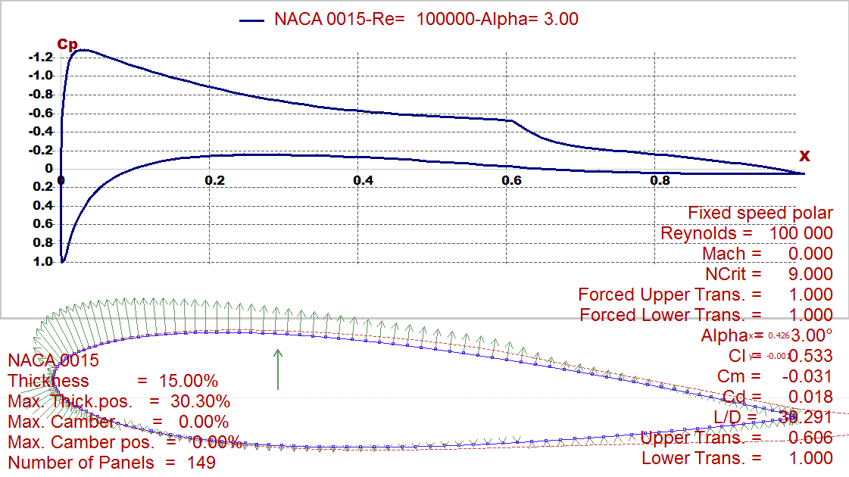
i. Foil characteristics

Slide 30
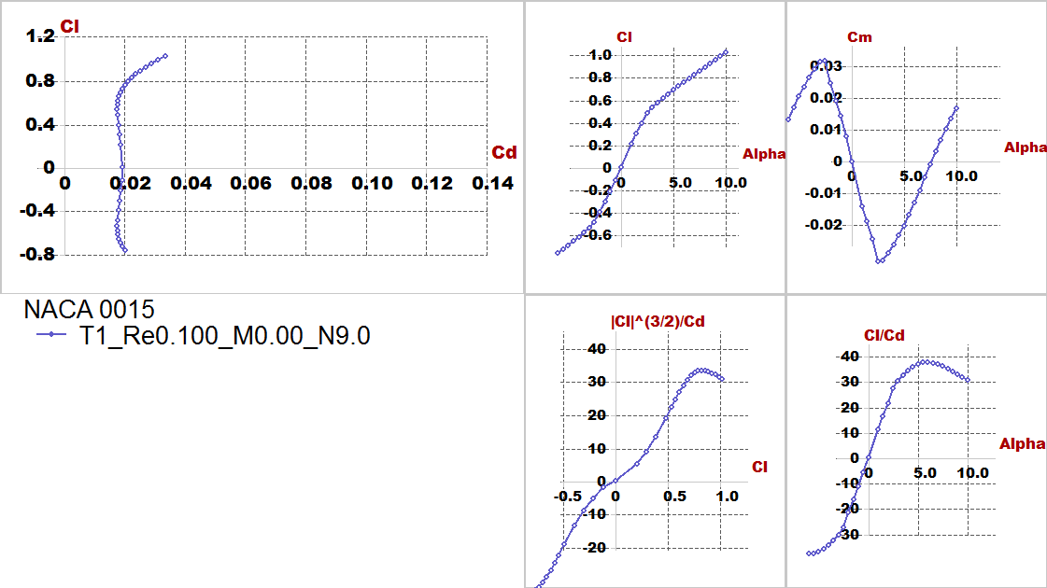

Slide 31
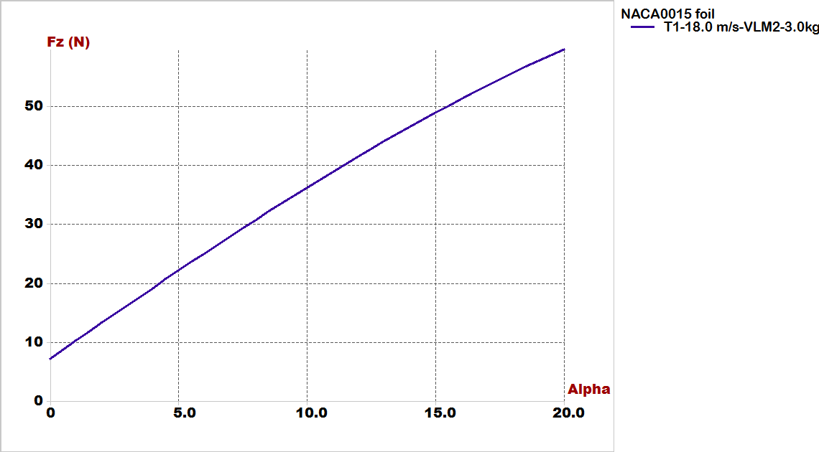
ii. Lift Vs alpha

Slide 32
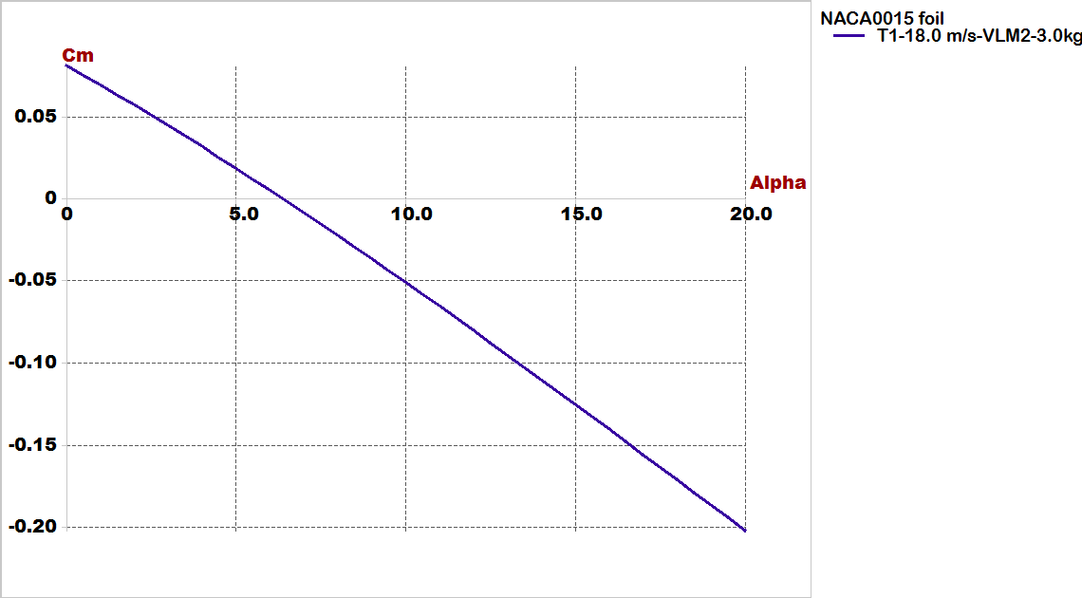
iii. Cm Vs alpha

Slide 33
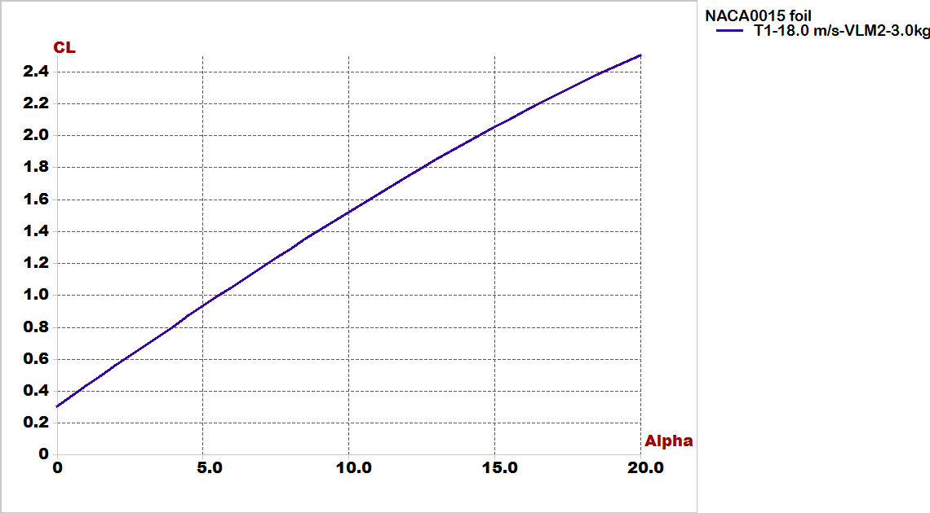
iv. Cl Vs alpha

Slide 34
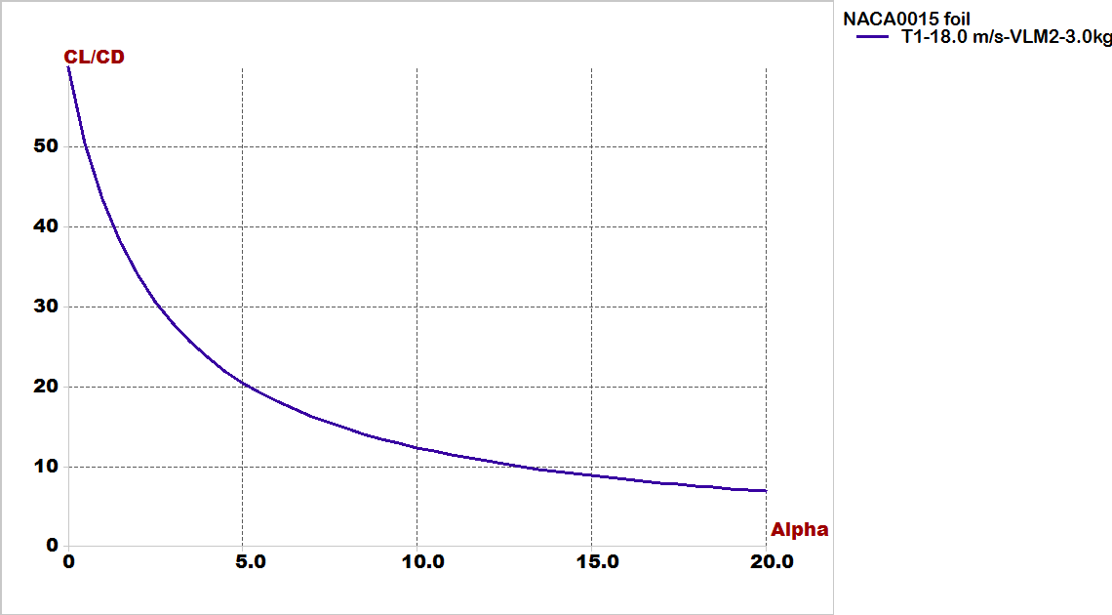
v. Cl/Cd Vs Cd:

Slide 35
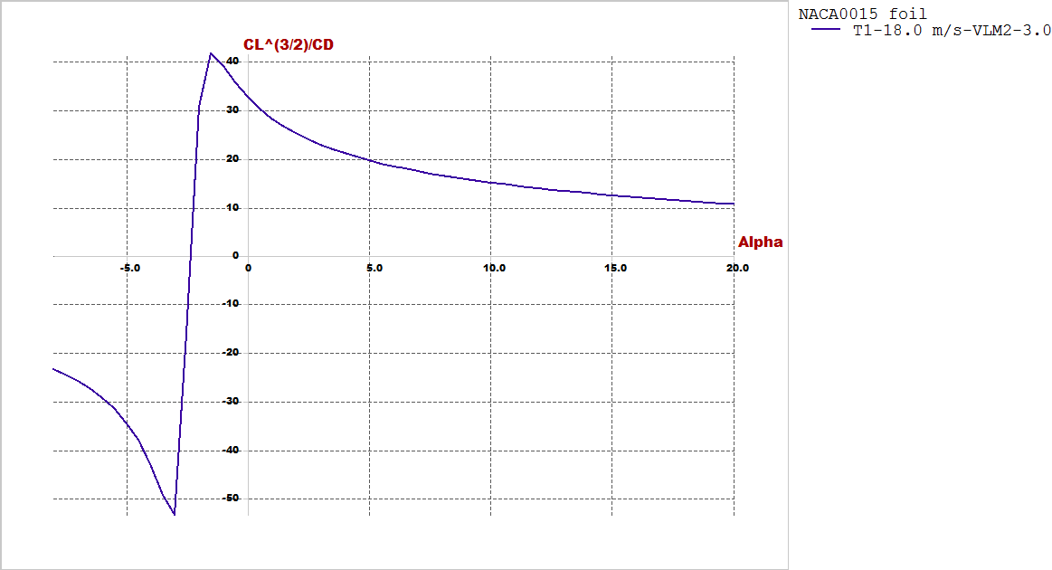
vi. Cl^(3/2)/Cd Vs alpha:

Slide 36
Stability Analysis

Slide 37
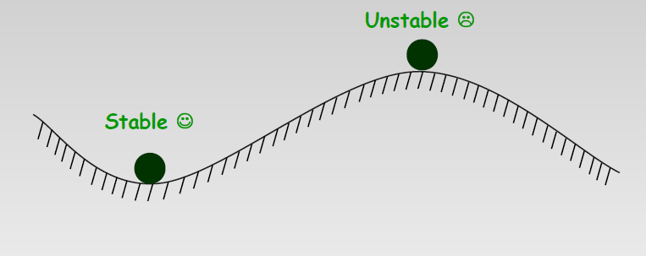
Static stability
Equilibrium is not stability

Slide 38
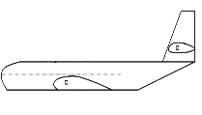

Longitudinal stability
C_{m}
For Static Longitudinal Stability :
$C_{m_{α}} MUST be NEGATIVE.$
$C_{m_{o}} MUST be Positive.$
C_{mo}
UnStable A/C
Nose
Up
Trim Condition
Cm = 0
α
Less Stable
Nose
Down
Stable A/C
More Stable A/C

Slide 39

Affect of C.G movement on the C_{m} – α curve :
C_{m}
C.G at Neutral Point
C.G more AFT
α
C.G at arbitrary position
C.G more Forward

Slide 40
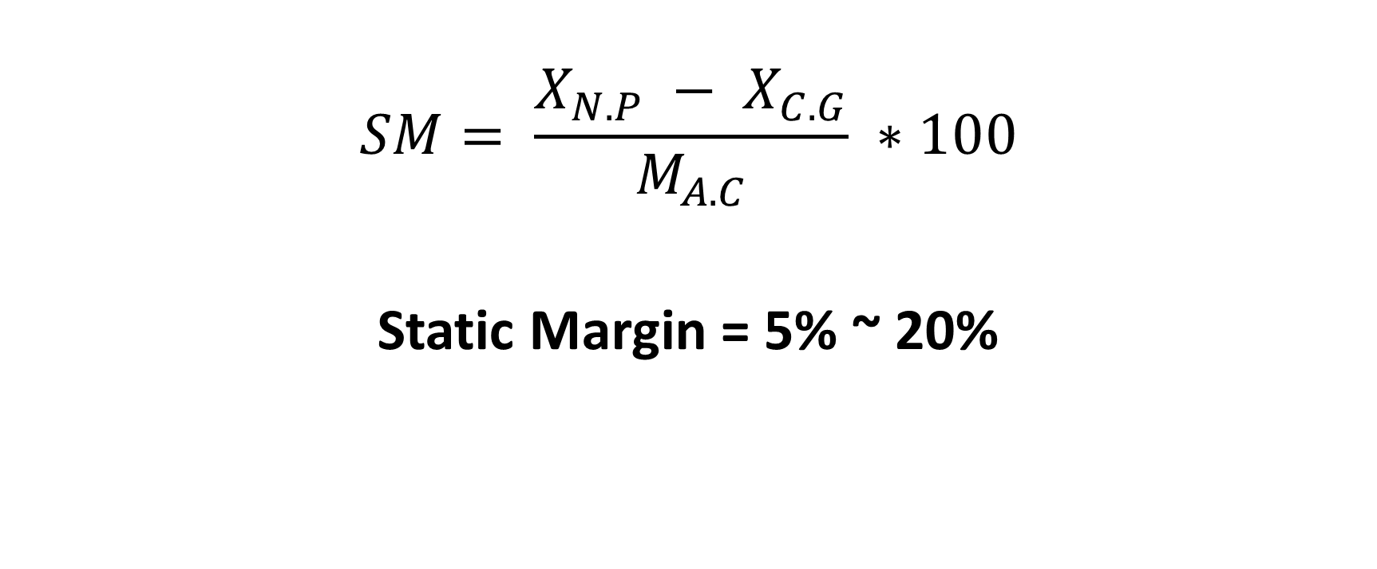
Static Margin
$$SM= \frac{X_{N.P} − X_{C.G}}{M_{A.C}} ∗100$$
Static Margin = 5% ~ 20%

Slide 41
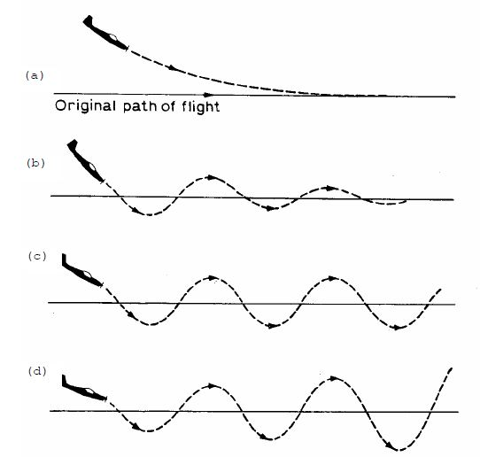
Dynamic stability
Positive
Dynamically Stable
Neutrally Stable
Negative
Dynamically Unstable

Slide 42

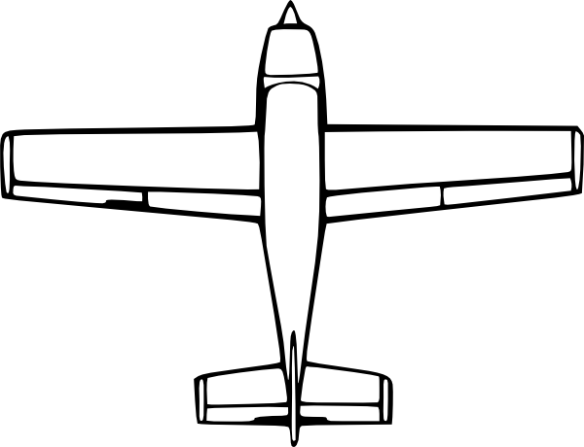

Directional static stability
β = Side Slip Angle
+ β
V∞
N Positive Yawing Moment
α
Directionally Statically Stable !
∆L
A symm. Airfoil is used for the Vertical Tail.

Slide 43
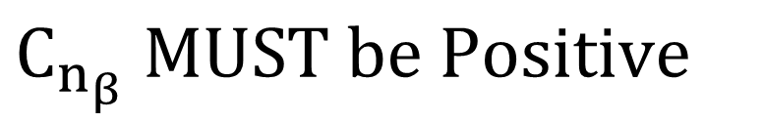
$$C_{n_{β}} MUST be Positive$$
C_{n}
Stable A/C
β

Slide 44
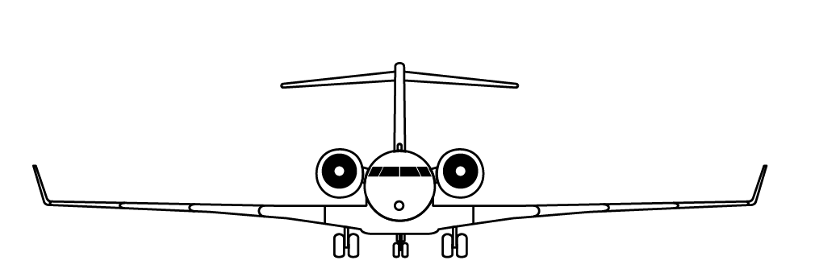

Lateral static stability
If the generated Rolling Moment returns the aircraft to Equilibrium
Then the A/C is Stable Laterally.
If the generated Rolling Moment moves the aircraft away from Equilibrium
Then the A/C is Unstable Laterally.

Slide 45
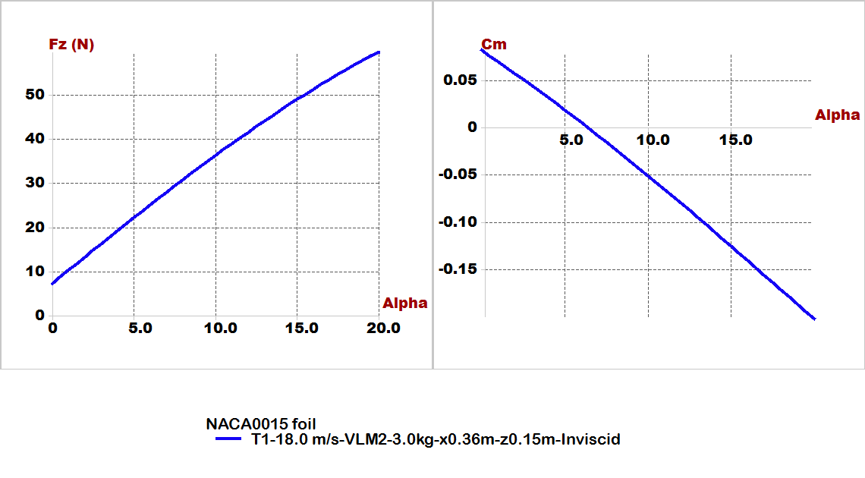
In experimental design checking for results very important by focus on 2 important figures:(longitudinal static stability and lift generated from airfoil)

Slide 46
Stability analysis:
We will illustrate this part by video its shown modes of longitudinal and lateral stability of plane by root locus and time response.
B. For lateral:
Type1: roll damping.
Type2,3: Dutch roll mode.
Type4: spiral mode.
For longitudinal:
Type1: short period mode.
Type2: Pitching.
Type3,4: motion around steady state flight.

Slide 47
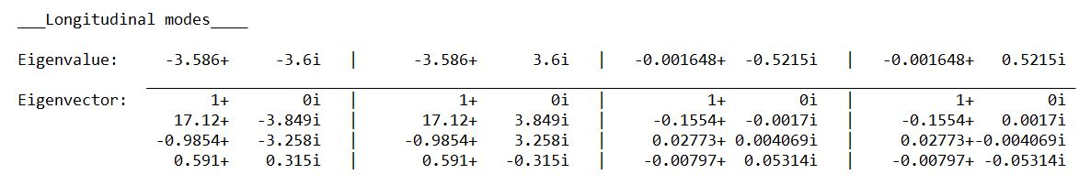
Root locus for longitudinal

Slide 48
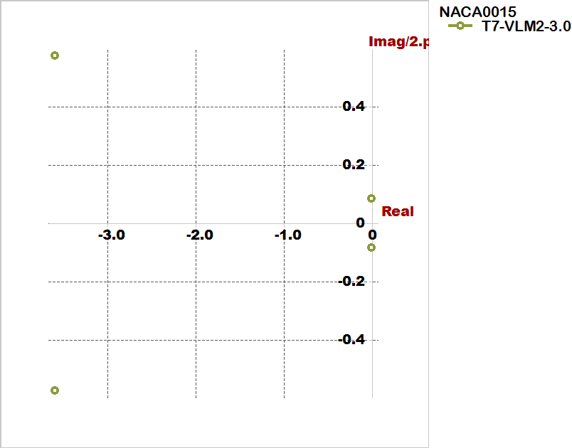

Slide 49
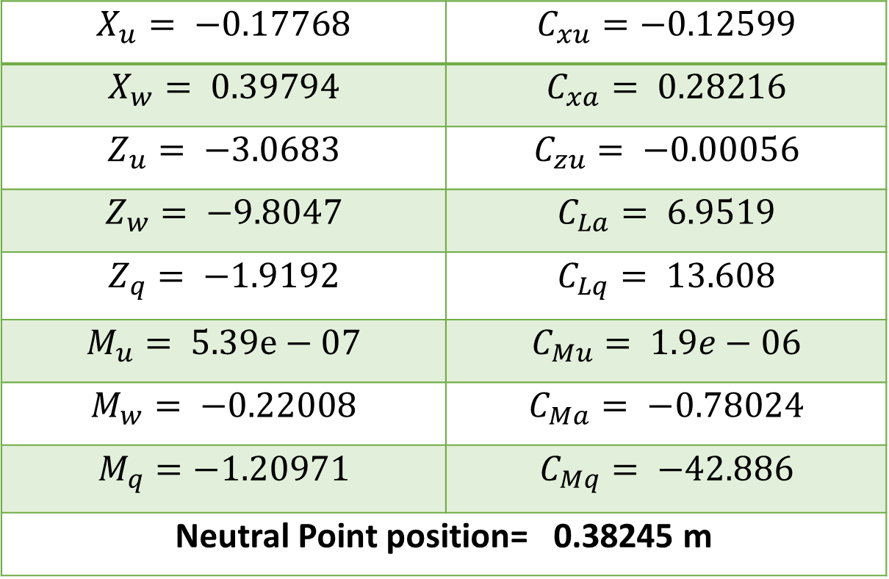
Longitudinal derivatives from Xflr5:
$$X_{u}= −0.17768$$ | $$C_{xu}=−0.12599$$
$$X_{w}= 0.39794$$ | $$C_{xa}= 0.28216$$
$$Z_{u}= −3.0683$$ | $$C_{zu}= −0.00056$$
$$Z_{w}= −9.8047$$ | $$C_{La}= 6.9519$$
$$Z_{q}= −1.9192$$ | $$C_{Lq}= 13.608$$
$$M_{u}= 5.39e−07$$ | $$C_{Mu}= 1.9e−06$$
$$M_{w}= −0.22008$$ | $$C_{Ma}= −0.78024$$
$$M_{q}=−1.20971$$ | $$C_{Mq}= −42.886$$
Neutral Point position= 0.38245 m

Slide 50
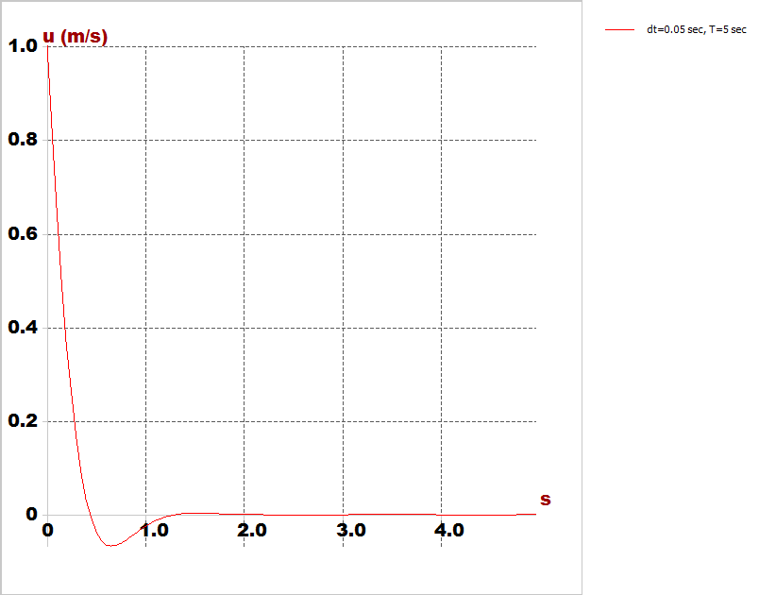
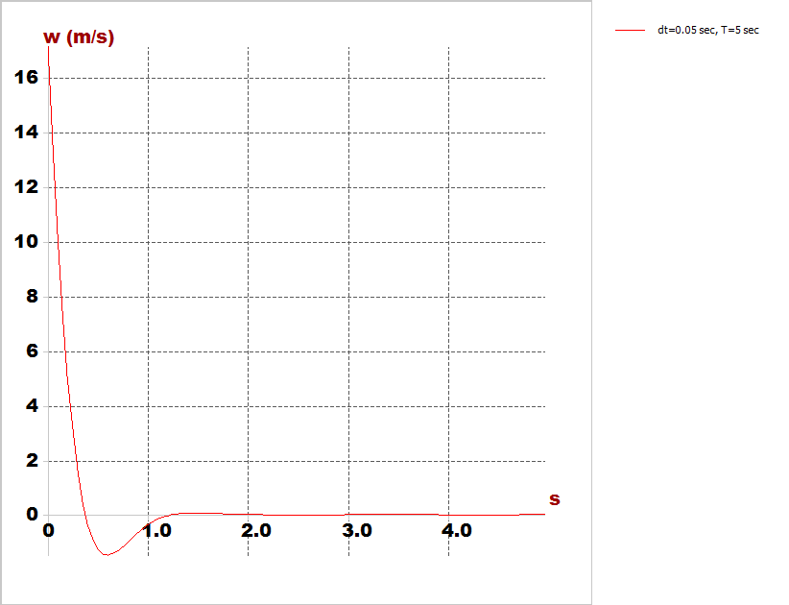
Time response characteristics
Horizontal speed response
Vertical speed response

Slide 51
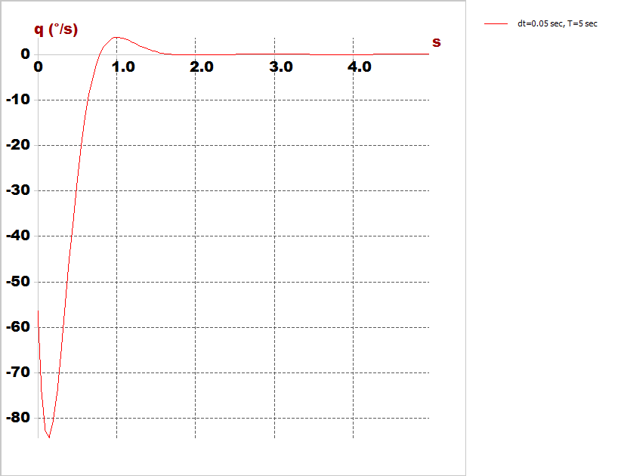
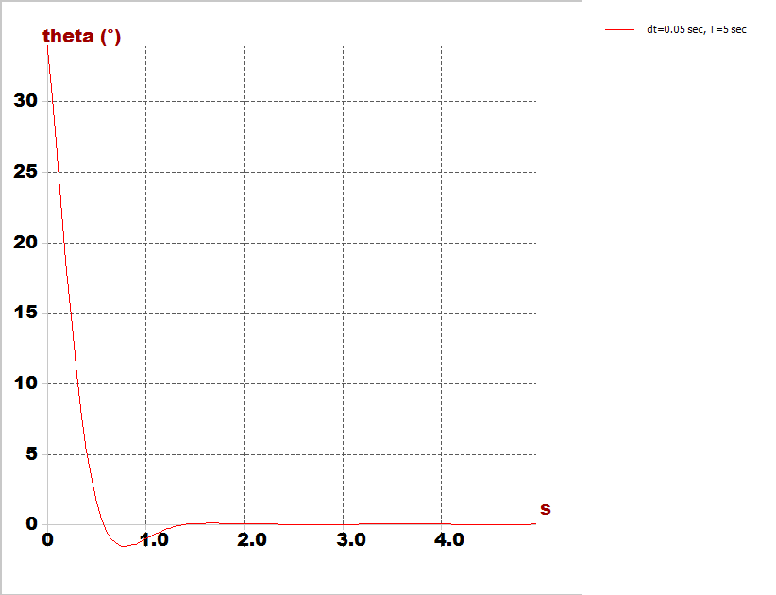
Time response characteristics
Pitch rate
Pitch angle

Slide 52
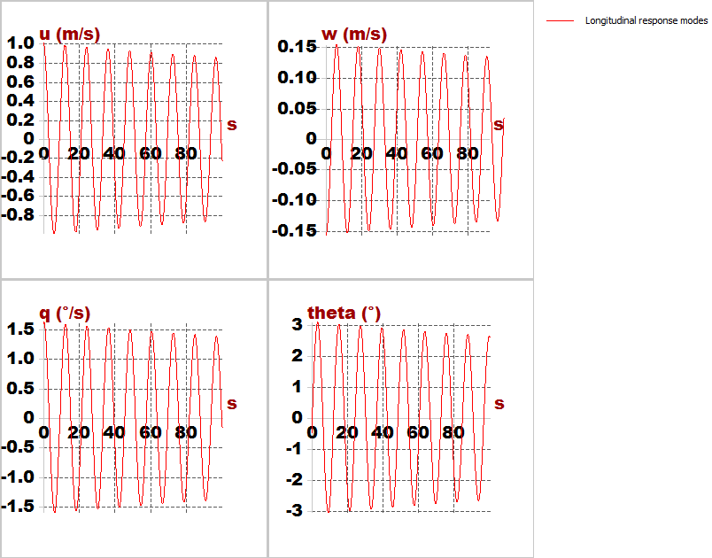
Time response characteristics

Slide 53
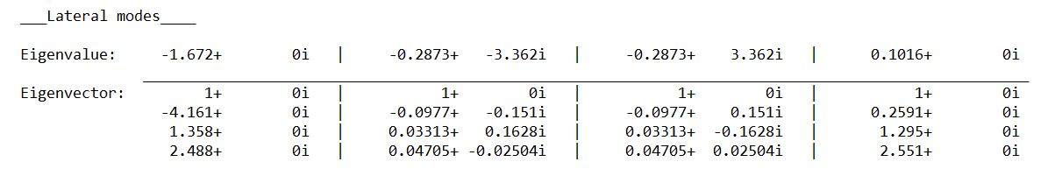
Root locus for lateral

Slide 54
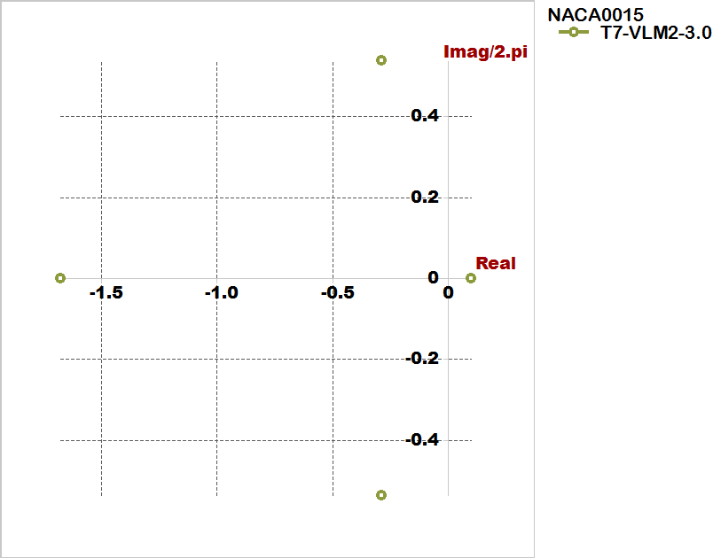

Slide 55
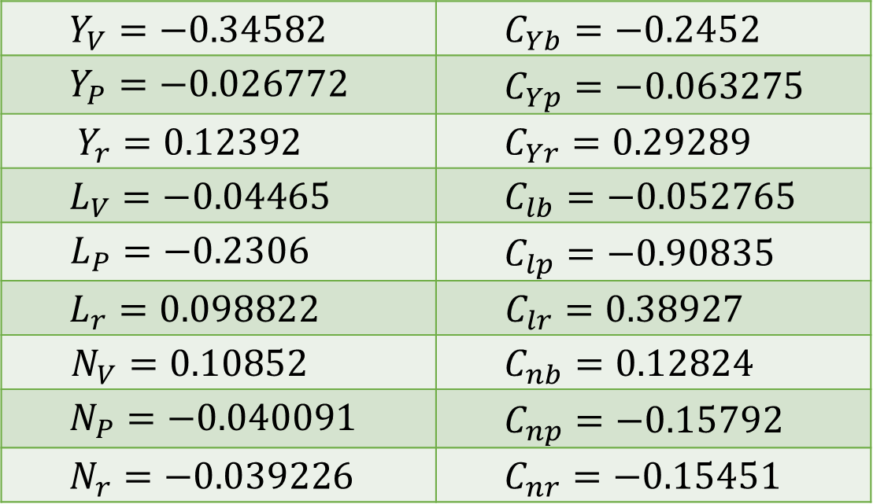
Lateral derivatives from Xflr5
$$Y_{V}=−0.34582$$ | $$C_{Yb}=−0.2452$$
$$Y_{P}=−0.026772$$ | $$C_{Yp}=−0.063275$$
$$Y_{r}=0.12392$$ | $$C_{Yr}=0.29289$$
$$L_{V}=−0.04465$$ | $$C_{lb}=−0.052765$$
$$L_{P}=−0.2306$$ | $$C_{lp}=−0.90835$$
$$L_{r}=0.098822$$ | $$C_{lr}=0.38927$$
$$N_{V}=0.10852$$ | $$C_{nb}=0.12824$$
$$N_{P}=−0.040091$$ | $$C_{np}=−0.15792$$
$$N_{r}=−0.039226$$ | $$C_{nr}=−0.15451$$

Slide 56
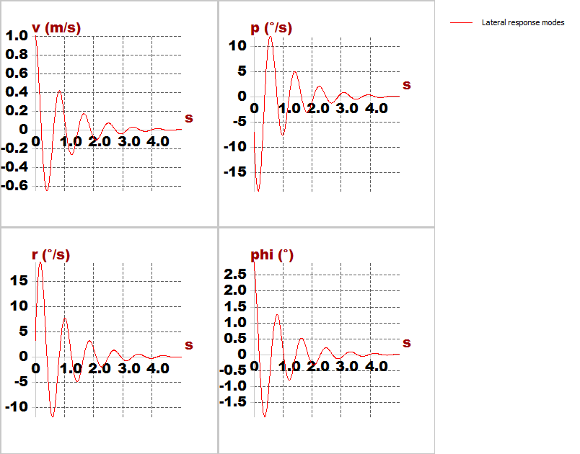
Time response characteristics

Slide 57
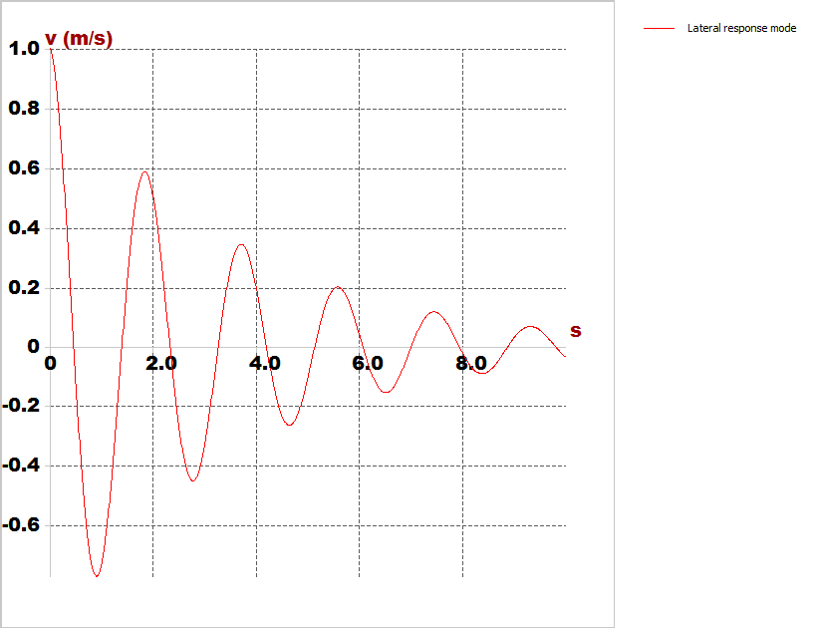
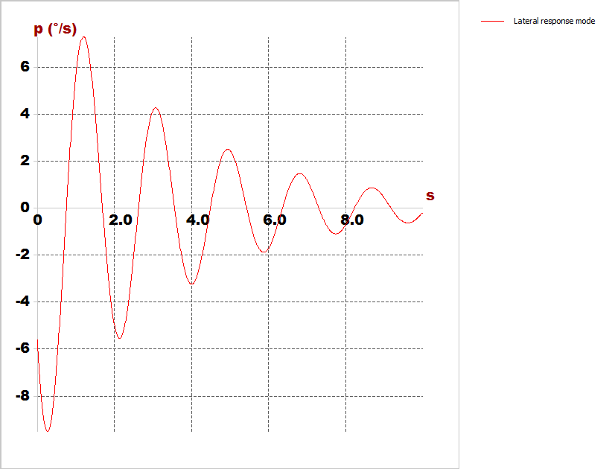
Time response characteristics
Cruise speed
Roll rate

Slide 58
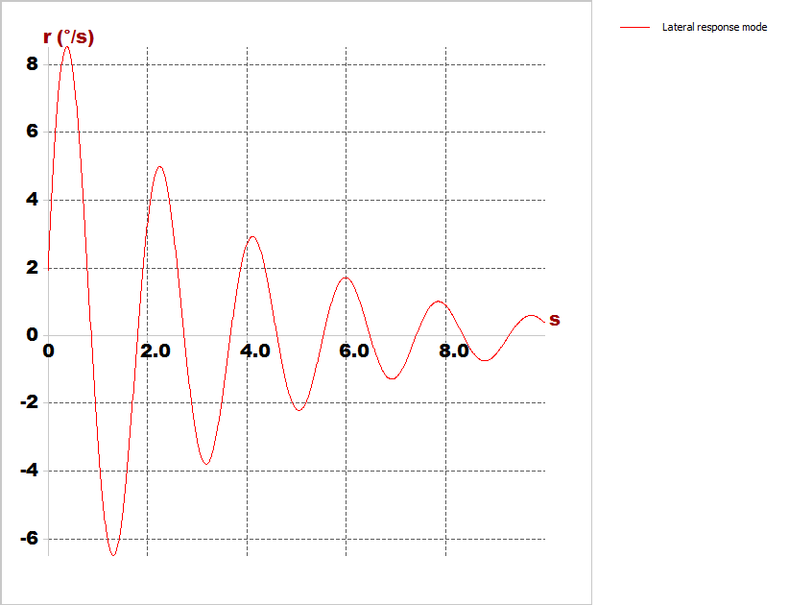
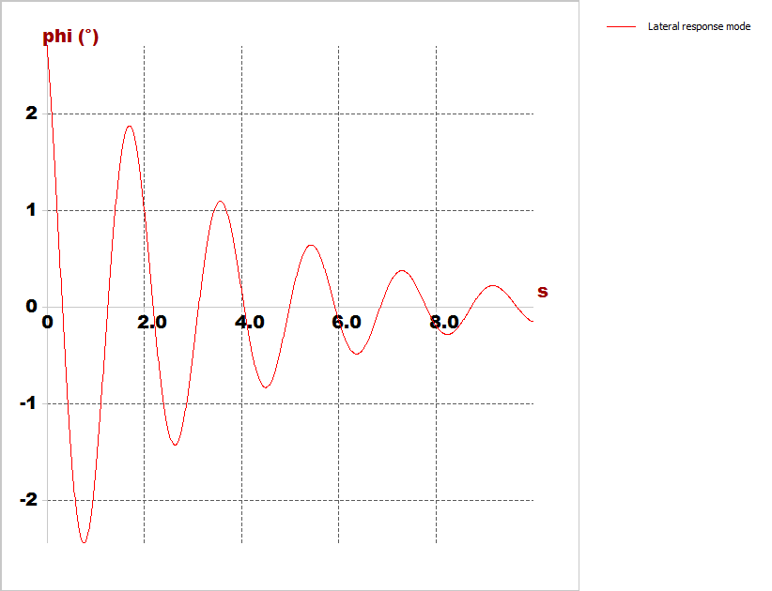
Time response characteristics
Yaw rate
Bank angle

Slide 59
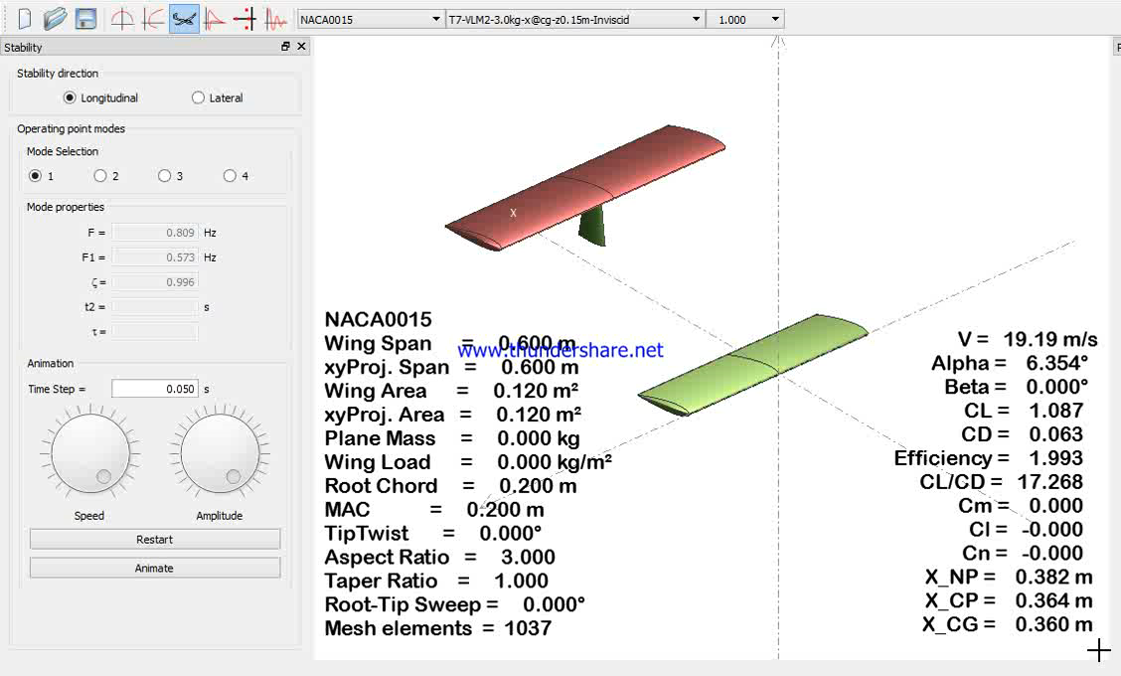
Longitudinal simulation

Slide 60
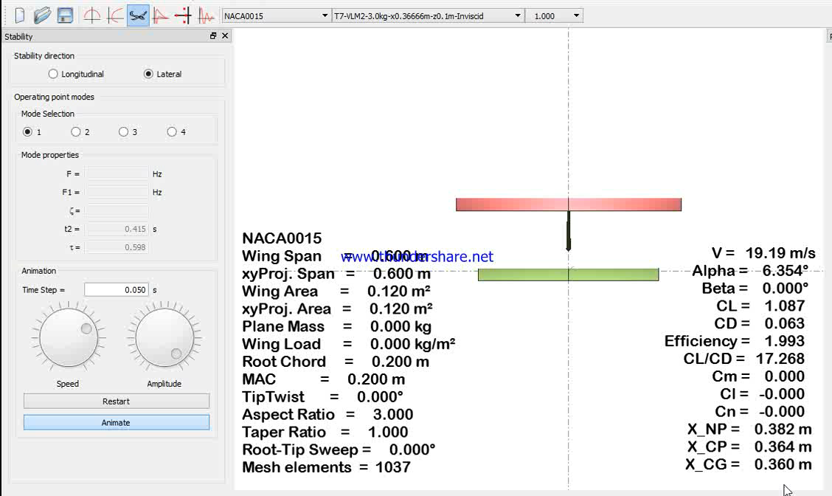
Lateral simulation

